Slide 1
Womanium Global Quantum+AI Project 2024
QML-for-Conspicuity-Detection-in-Production
Team - Quantum Codex
Ramachandran Sekanipuram Srikanthan
Shruti Taksali
Repo - https://github.com/RamAIbot/qml_fault_detection
Report - qml_fault_detection/Womanium Quantum + AI Project 2024 Report.pdf at master · RamAIbot/qml_fault_detection (github.com)
Womanium Quantum+AI Project 2024

Slide 2
Introduction
The project focuses on identifying Weld defects using non destructive testing (NDT). The Tungsten inert gas (TIG) [1] welding is an arc welding process which is mainly used in joining high value precision components together.
The automation of the TIG welding process is crucial for overcoming its current limitations in manual process to ensure high-quality results.
Computer Vision (CV) methodologies are used to find out whether the welded item is perfect for production or needs to be scraped using high dynamic range (HDR) cameras.
We will be using this dataset of images collected and preprocessed by Kaggle [2] and are available open source to train Deep learning and Quantum Machine learning models capable of identifying Weld defects in an automated, fast and less error prone manner.
The model is trained to detect these 6 types of defects with significant accuracy.
1. good weld
2. burn through
3. contamination
4. lack of fusion
5. misalignment
6. lack of penetration
Womanium Quantum+AI Project 2024

Slide 3
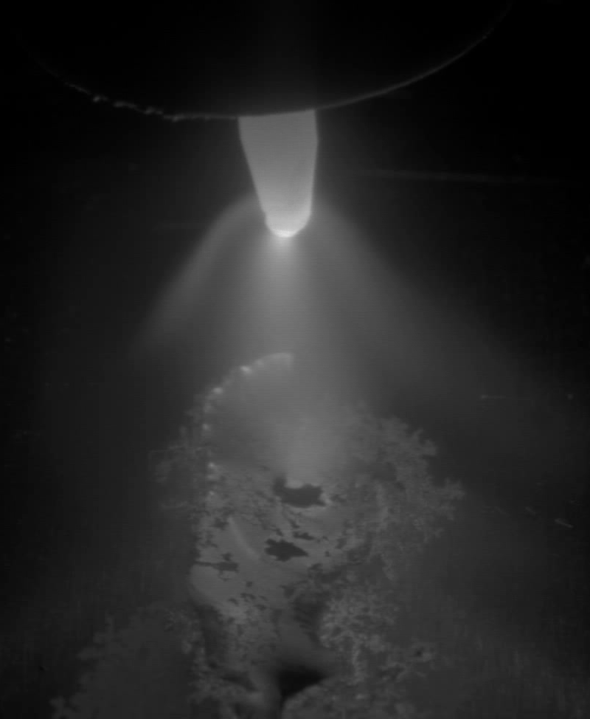
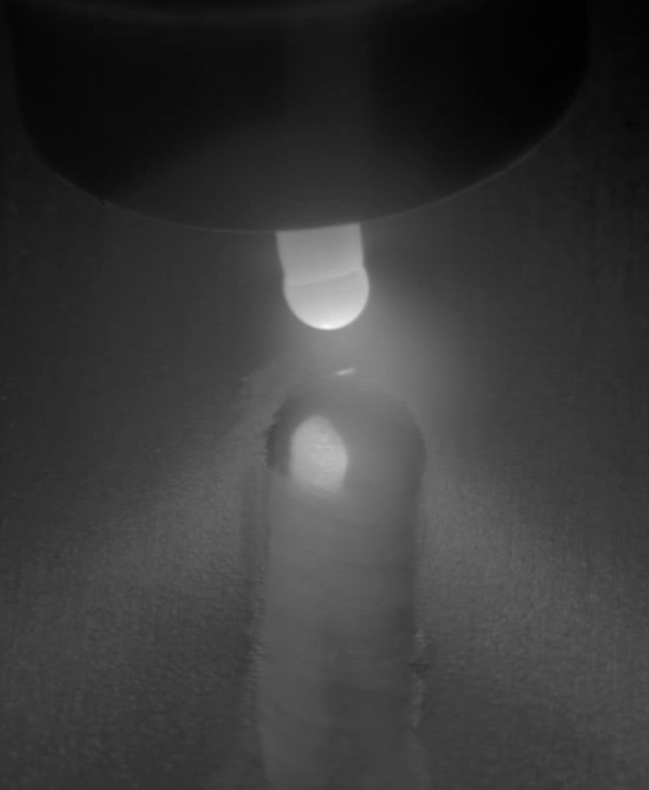
Various Weld fault examples - Kaggle dataset
Womanium Quantum+AI Project 2024

Slide 4
Modeling
We will be using these modeling approaches for performing classification.
Deep learning
The key idea in using Deep learning based approach is that, there is no need for manual feature detection which can be passed to a model for training. The deep learning algorithm learns to find out the necessary features which are required for providing a better classification result.
Hybrid Quantum Machine learning (QML)
We will be mainly exploring hybrid quantum models instead of pure quantum models as the pure quantum models are linear and it is not possible to model non-linear dataset using pure quantum models with much accuracy. Also, pure quantum models are prone to Barren plateau issues as the depth and number of qubits are increased, it becomes nearly impossible to converge to global minima. These Hybrid models having a Classical deep neural network feature extractor followed by a linear quantum model solves the above problems. The Classical model can tune the features based on the functioning of the quantum model learnt through the backpropagation of the loss.
Womanium Quantum+AI Project 2024

Slide 5
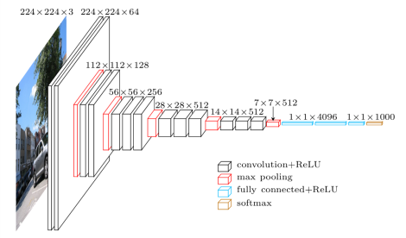
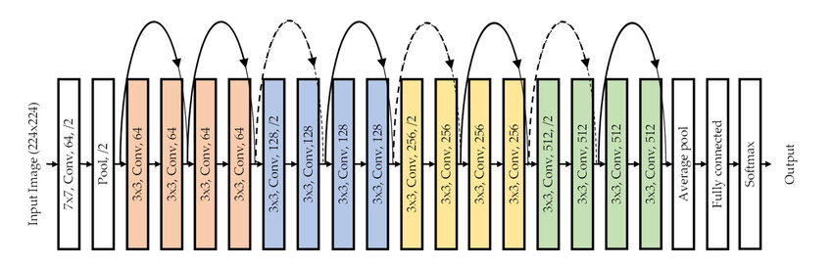
Classical models
VGG19
It used various convolutional windows which extracts features from the image and finally flatten them to be passed to a linear classifier.
Resnet18
As the models becomes more deeper, the vanishing and exploding gradient problem arises and affect training. Resnet18 solves that by having feed-forward connections.
Source - Structure of the Resnet-18 Model. | Download Scientific Diagram (researchgate.net)
Source - [1409.1556v6] Very Deep Convolutional Networks for Large-Scale Image Recognition (arxiv.org)
Womanium Quantum+AI Project 2024

Slide 6
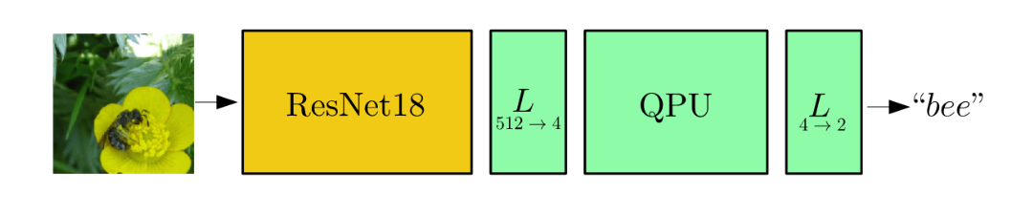
Hybrid Quantum Models
In hybrid quantum models, we will be using feature extracted from classical model and mass it to the quantum space.
The quantum model have 4 modules
Initial State - It can be in all zero states or it can be in superposition of all possible states for a set of qubits
State preparation - In this stage, the classical features are mapped into the hilbert space.
Ansatz - Here, we perform the training operation. The Ansatz contains a set of gates along with linear entanglement with trainable parameters which can be optimized to map a curve function.
Measurement - Here we convert the data from the hilbert space to the classical world.
Source - Quantum transfer learning | PennyLane Demos
Womanium Quantum+AI Project 2024

Slide 7
Quality metrics
We will be using the accuracy as the quality metrics. The dataset is divided into the train, validation and testing. The test dataset will not be shown to the model during training time.
The accuracy of the test data is found by number of correct prediction with respect to total predictions. Additionally, a confusion matrix can also be used to find out the classification accuracy for each classes.

Slide 8
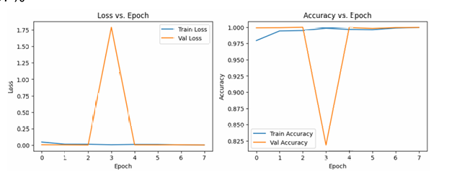
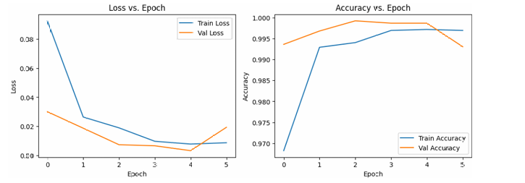
Binary classification
Resnet-18 Model
Train Accuracy- 99.49%
Validation Accuracy- 100 %
Test Accuracy- 97%
Hybrid QML based on Resnet18
Train Accuracy- 99.40%
Validation Accuracy- 99.92%
Test Accuracy- 92%
Womanium Quantum+AI Project 2024

Slide 9
Multi class classification
Hybrid QML models
Resnet- 18
Train Accuracy- 99.99%
Validation Accuracy- 99.92%
Test Accuracy- 79%
VGG19
Train Accuracy- 100%
Validation Accuracy- 99.96%
Test Accuracy- 82%
Classical type | Qubits | Ansatz depth | Embedding | Entangler | Train Acc | Val Acc | Test Acc
Resnet18 | 4 | 4 | angle | basic | 98.58 | 99.68 | 58
Resnet18 | 4 | 4 | angle | strongly | 88.84 | 89.14 | 59
Resnet18 | 4 | 8 | angle | basic | 98.7 | 99.08 | 56
Resnet18 | 10 | 4 | angle | basic | 98 | 99.38 | 58
Resnet18 | 4 | 4 | amplitude | basic | NA | NA | NA
VGG19 | 4 | 4 | angle | basic | 32.88 | 32.7 | NA
Womanium Quantum+AI Project 2024

Slide 10
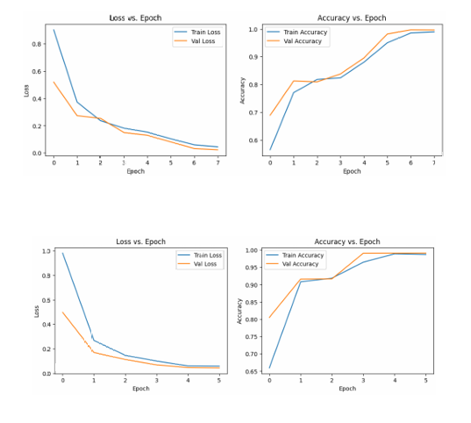
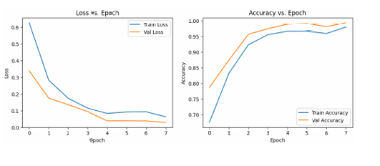
Qubits vs depth
We can note that convergence for the loss curve doesn’t change that much with an increase in depth from 4 to 8 (Graph 1 and 2). This is due to the fact that, even though we have a large number of trainable parameters with increase in depth, due to the Barren plateauing effect [6] (where the optimization landscape becomes much flatter), we are not able to leverage the advantages of a large number of trainable parameters.
On the other hand, with an increase in the number of qubits from 4 to 8 (Graph 1 and 3) and having the same depth of 4, the convergence becomes faster. So, we can note that having a large number of qubits with lesser depth is better than having a smaller number of qubits with large depth.
Graph 1
Graph 3
Womanium Quantum+AI Project 2024
Graph 2

Slide 11
References
Daniel Bacioiu, Geoff Melton, Mayorkinos Papaelias, Rob Shaw,Automated defect classification of Aluminium 5083 TIG welding using HDR camera and neural networks, Journal of Manufacturing Processes, Volume 45, 2019, Pages 603-613, ISSN 1526-6125,https://doi.org/10.1016/j.jmapro.2019.07.020.
B, D. (2018, October 11). TIG aluminium 5083. Kaggle. https://www.kaggle.com/datasets/danielbacioiu/tig-aluminium-5083?resource=download
He, K., Zhang, X., Ren, S., & Sun , J. (2015). Deep Residual Learning for Image Recognition. arXiv. https://doi.org/https://doi.org/10.48550/arXiv.1512.03385
Pennylane. PennyLane. (n.d.). https://pennylane.ai/
Get started. PyTorch. (n.d.). https://pytorch.org/
McClean, J. R., Boixo, S., Smelyanskiy, V. N., Babbush, R., & Neven, H. (2018a). Barren Plateaus in quantum neural network training landscapes. Nature Communications, 9(1). https://doi.org/10.1038/s41467-018-07090-4
Mottonen, M., Vartiainen, J. J., Bergholm, V., & Salomaa, M. M. (2005). Transformation of quantum states using uniformly controlled rotations. Quantum Information and Computation, 5(6), 467–473. https://doi.org/10.26421/qic5.6-5.
Schuld, M., & Petruccione, F. (2019). Supervised learning with Quantum Computers. Springer.

